Slide 1

Brewing Success: A Data-Driven Dive into Coffee Shop Analytics
Embark on a caffeinated journey through coffee shop data. Uncover hidden patterns in customer behavior. Explore revenue drivers across locations and product categories. Discover the secrets to brewing success through data-driven insights.

Slide 2

Dataset Overview
The dataset comprises 149,116 rows and 11 columns of transactions. Spanning January to June 2023, it details every coffee shop interaction. Each entry captures transaction IDs, store locations, and product specifics. Meticulously curated, the dataset boasts impeccable data integrity.
Comprehensive
Clean
149,116 transactions
No missing values
Detailed
Includes product, location, time

Slide 3
Revenue by Location
Explore revenue variations across different locations. A clear leader emerges from the analysis. Lower Manhattan brewed the most success. It raked in over $700,000 in revenue. Hell's Kitchen followed with approximately $500,000. Astoria completes the top revenue generating locations.
Lower Manhattan
Hell's Kitchen
Astoria
$700,000+
~$500,000
High Revenue

Slide 4

Coffee: The Reigning Champion
Among a diverse range of products, coffee stands out. This beloved beverage generated $269,952 in revenue. Tea trailed behind at $196,406. Coffee solidifies its position as the top-selling product. It highlights its central role in driving revenue.
$269K
Coffee
$196K
Tea

Slide 5
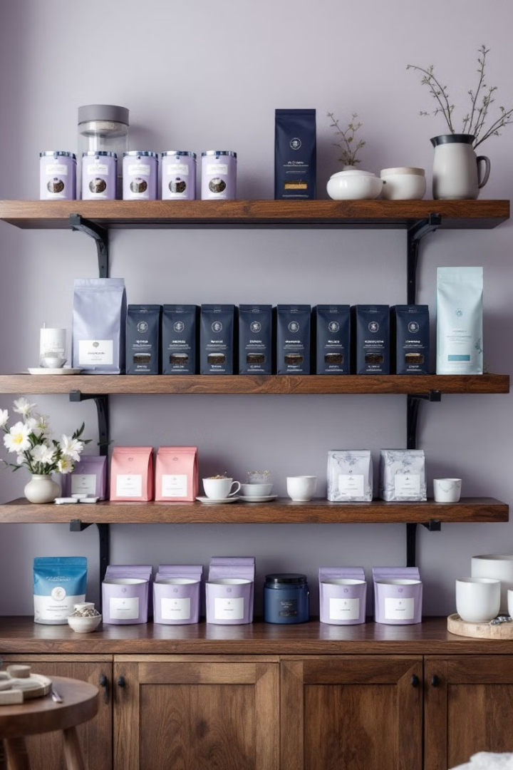
Customer Favorites
Uncover customer preferences through best-selling items. Earl Grey leads with 4,708 units. Dark Chocolate follows closely with 4,668 units. Morning Sunrise Chai and Latte are also popular. Customer choices reflect taste, tradition, and comfort.
1
Earl Grey
2
Dark Chocolate
4,708 units
4,668 units
3
Morning Sunrise Chai
4,643 units

Slide 6

The Rhythm of the Day
Transaction patterns reveal key insights into timing. The peak hours are between 7 a.m. and 10 a.m. The highest transaction count occurs at 10 a.m. with 26,713 transactions. Mornings are crucial for revenue generation and customer engagement.
1
7 a.m.
Transactions start to increase
2
10 a.m.
Peak transaction time

Slide 7
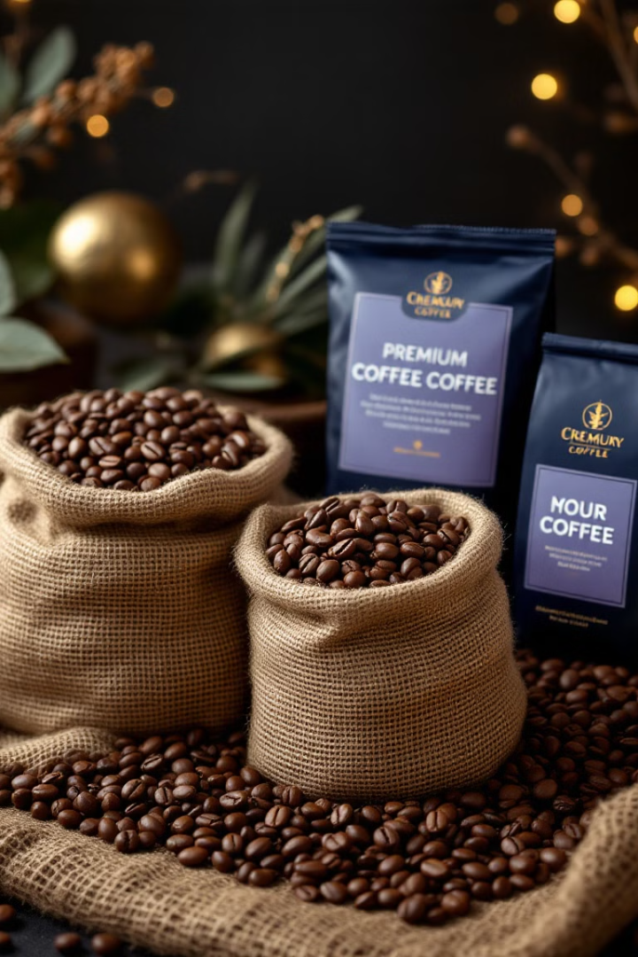


Analyzing Price vs. Impact
Product pricing holds important insights. Premium beans average $34, niche sales correspond to higher prices. The correlation between price and quantity is slightly negative. The correlation is -0.12, indicating low price sensitivity.
$34 Avg
-0.12 Corr
Premium Beans
Price Sensitivity

Slide 8
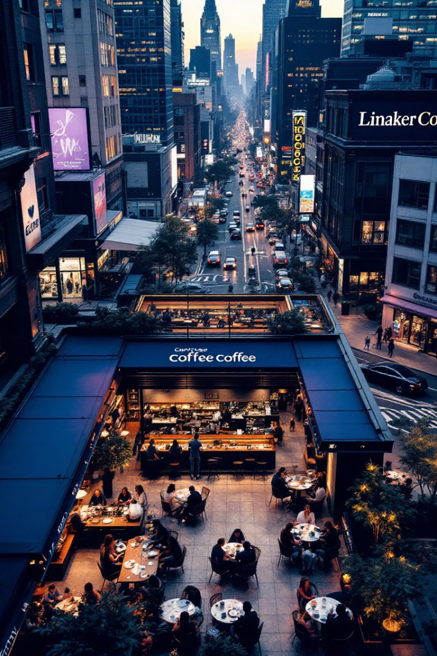



Key Takeaways
The coffee shop story is one of flavor, timing, and location. The average transaction value is $4.69. Most transactions fall within a typical range. Customer spending reveals patterns of indulgence. By acting on these insights you can improve business.
Optimize inventory
Targeted promotions
Strategic locations

